Slide 1
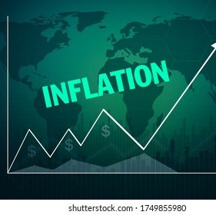
INFLATION FORECASTING
GROUP 10
YASH SHAH
ANUSHKA UBRIANI
ADITYA JADHAV

Slide 2

AGENDA
Introduction & Background
Objective
Dataset Description/Preparation
Data Analysis & Forecasting Methods
Conclusion
Q&A

Slide 3
What Is Inflation?
Inflation is defined as a general increase in the price of goods and services across the economy, or, in other words, a general decrease in the value of money.
As inflation occurs, individuals can purchase fewer goods and services with the same amount of money. Example- An individual would need about $304 in 2020 to purchase the same amount of goods and services as $100 would have purchased in 1980.
The rate of inflation can be measured by observing changes in the average price of a consistent set of goods and services, often referred to as a market basket. Different inflation measures are calculated differently. For example, the CPI uses a fixed basket of goods and services
Inflation is generally measured using a price index, such as the Consumer Price Index(CPI). A price index is constructed by dividing the price of a market basket each year by the price of the same basket of goods in a base year. The rate of inflation is then measured by calculating the percentage change in the price index across different periods.

Slide 4
Consumer Price Index (CPI) is a key variable which indicate the overall price level of basket of goods and services in a country.
Inflation is one of the important variable that can influence the whole economy and government policy defined as rate of change in CPI. Inflation not only affects the individual as well as economy. To maintain a rapid growth in the economy it is very important to maintain inflation at threshold level. High inflation with a momentum can be an indication of diluting economy. On the other hand, low inflation may also have negative impact on growth
Numerous studies have been made to forecast inflation using different models. There are mainly two types of models used, theoretical and statistical. Present study belongs to the types of model which are statistical. These models are purely based on data.

Slide 5
Objective
Predicting the economic future in terms of future Inflation trends—along with how the business will respond. The application of time series models on the datasets will provide the inflation rate trends and patterns over the years.
Forecasting inflation is one of the core responsibilities of economists at central banks and in the private sector, and models of inflation dynamics play a central role in determining monetary policy.
An accurate business forecast is used to create business budgets, allocate funding, make decisions about cash flow and credit needs, and to create timelines for new initiatives or acquisitions.
This type of analysis can allow businesses to prepare for shifts in the market or a change in demand. Business forecasting may change the investment and saving strategies of businesses and individuals, as well as affect the timing of new offerings.
Such understanding will help Investors, traders, financial institutions, regulators and other stakeholders to use it as a reference point for determining Inflation over a specific time such as one year, one quarter or over a few months.

Slide 6
Forecasting methods
This research summary reviews our work based on various Forecasting methods used on the dataset.
The process involves the collection of primary and secondary sources of data, analyzing the data, creating strategies for forecasting, and then comparing the projections to the realized outcomes.
Forecasting Methods used: Naïve Method, Simple Moving Average Method, Simple Exponential Smoothing, Holt-Winter Model & ARIMA Model

Slide 7
Dataset Description:
We have used the data provided by the world bank for forecasting the inflation rate for the coming years of the United States. We have implemented this using R.
Using Inflation trends, we intent to use past values for USA which will be helpful in forecasting future inflation. The data that we are using is based on Inflation as measured by the consumer price index reflecting the annual percentage change in the cost to the average consumer of acquiring a basket of goods and services that may be fixed or changed at specific intervals on yearly basis
This is an Economic Forecast and a Point forecast.
In terms of time component, this is a Long Forecast. The trends are defined annually ranging from the year 1960-2020.
The dataset has 60 observations from 1960-2020.

Slide 8
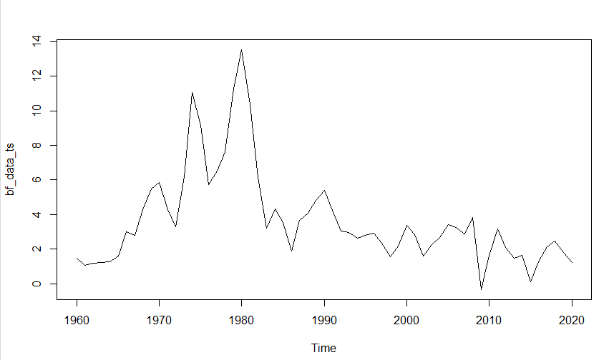
Time Series Plot
The time series shows an increasing trend in inflation from 1960 to 1980. It reached around 13.5%
Post 1980 we see a massive fall in the inflation rate due to a recession between 1980-1982.
From 1983 onwards we see a stable graph

Slide 9
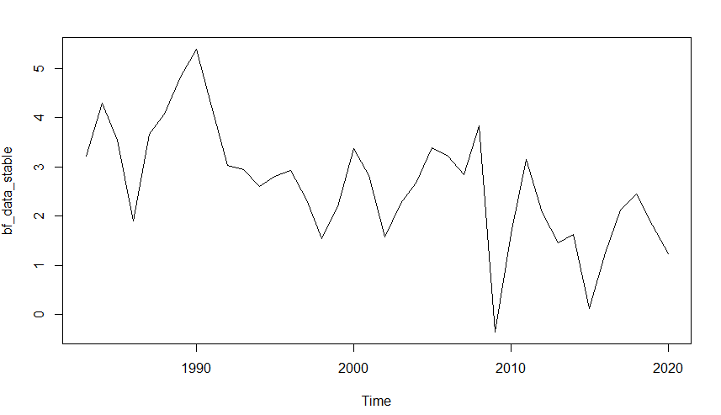
Stabilized plot explanation
From 1983-2020 onwards, we see a stability in the inflation rates without a massive fall or increase.
The highest inflation here is around 5.2% and lowest around -0.5%

Slide 10
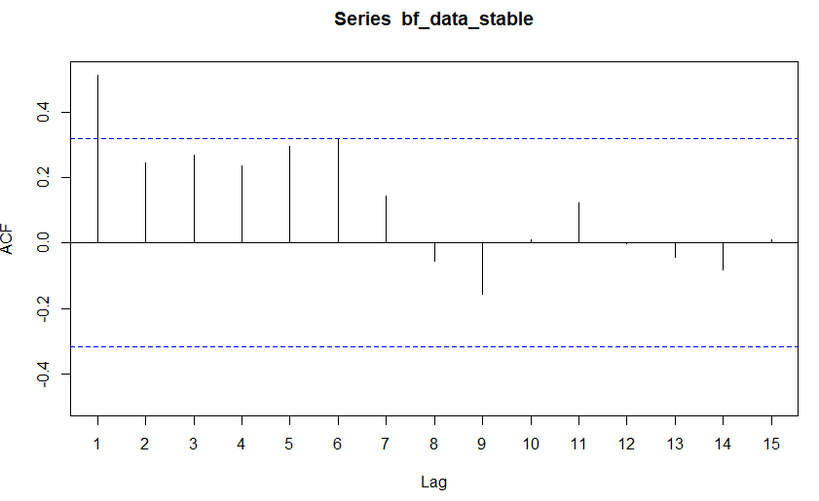
Stabilized ACF plot

Slide 11
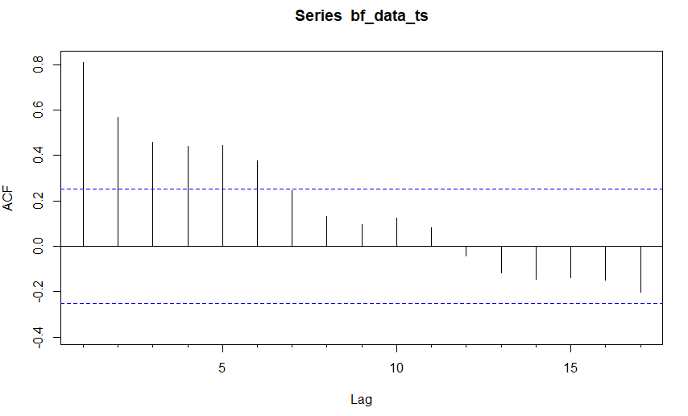
Time series ACF plot

Slide 12
Naïve Model
The first method used is the the naïve forecast method. A naive forecast is one in which the forecast for a given period is simply equal to the value observed in the previous periods.
This is implemented using the 'naive()' function.
This method may not be the best forecasting technique, but it often provides a useful benchmark for other, more advanced forecasting methods.
We have kept h=3 in order to predict for the next 3 years: 2021, 2022, 2023
#Naive Method
naive_stable = naive(bf_data_stable, h = 3)
naive_stable
plot(naive_stable)
accuracy(naive_stable)
attributes(naive_stable)
plot(naive_stable$residuals)
Acf(naive_stable$residuals)
plot(naive_stable$fitted, naive_stable$residuals)
plot(naive_stable$x, naive_stable$residuals)
plot(naive_stable$fitted, naive_stable$residuals, xy.labels = FALSE, xy.lines = FALSE)
plot(naive_stable$x, naive_stable$residuals, xy.labels = FALSE, xy.lines = FALSE)
forecast(naive_stable, h = 3)

Slide 16
Takeaways:
The blue portion depicts the forecast for the next 3 years: 2021, 2022, 2023.
The forecast is basically a lagged version of the actual line.
This is exactly what we would expect the plot to look like since the naive forecast simply forecasts the Inflation in the current period to be equal to the Inflation in the previous period.
To know if this forecast is useful, we have compared it to other forecasting models and check if the accuracy measurements are better or worse.

Slide 17
Moving Averages
Smoothing methods are a family of forecasting methods that average values over multiple periods in order to reduce the noise and uncover patterns in the data. Moving averages are one such smoothing method.
Moving Average model is the basic model used for univariate time series. The output variable in the MA model has a linear dependence on the current or the past values. A new series is developed based on the average of the current/past values.
Trendspotting becomes easy using the moving average time series model. The moving average is extremely useful for forecasting long-term trends.

Slide 18
Types of Moving Averages:
Simple Moving Average- The simplest form of a moving average, known as a simple moving average (SMA), is calculated by taking the arithmetic mean of a given set of values over a specified period. In other words, a set of inflation rates–are added together and then divided by the number of observations.
Exponential Moving Average (EMA)- The exponential moving average is a type of moving average that gives more weight to recent rates in an attempt to make it more responsive to new information. To calculate the EMA first simple moving average (SMA) is computed over a particular time period.
The main difference between simple moving average, weighted moving average, and exponential moving average is the sensitivity that each shows to changes in the data used.
SMA calculates the average price over a specific period, while WMA gives more weight to current data.
EMA is also weighted toward the most recent prices, but the rate of decrease between one price and its preceding price is not consistent but exponential.

Slide 19
This is implemented using the ‘ma()' function on our data.
We have taken order values to be 3,6 and 12 in order to specify the window size or the order that we want the moving average to be calculated. We average all the values to get a weighted average for each observation in our dataset.
#Moving Averages
ma_3 = ma(bf_data_stable, order = 3)
ma_6 = ma(bf_data_stable, order = 6)
ma_12 = ma(bf_data_stable, order = 12)
plot(bf_data_stable)
lines(ma_3, col = "red", lwd=3)
lines(ma_6, col = "blue", lwd=3)
lines(ma_12, col = "green", lwd=3)
plot(ma_3)
plot(ma_6)
plot(ma_12)
ma_forecast = forecast(ma_3, h = 1)
ma_forecast

Slide 23
Takeaways:
Here, we can see the ma generated being laid over at the top of the raw data and we can see the effect of it is dampening of the signals. So, if a year is particularly high but if the month surrounding it aren’t it will lower those values smoothing over this jagged month-to-month variation.
So, you can see as more of the general trends over time as the inflation is changing. You can also see that the lines start and stop before the data ends and that again is because of the varying window sizes that we chose. What this really means is that it really truncates the two ends
A shorted window size takes the most recent data points in consideration rather than the entire data. Fairly big window size will give us the total annual scale average of what the inflation was.
By calculating the moving averages, the impacts of random, short-term fluctuations on the rates of inflation over a specified time frame can be mitigated.

Slide 24
Exponential Smoothing:
Exponential Smoothing, ES is the model that also uses univariate time series. The values, however, in the case are determined from the weighted average of the past values. Trends and seasonality can be identified using the ES model.
In the exponential smoothing, we weigh the recent values or observations more heavily rather than the old values or observations. The weight of each parameter is always determined by a smoothing parameter or alpha. The value of alpha lies between 0 and 1.

Slide 25
This is implemented using the ‘ets()' function on our data. The accuracy is calculated, and residual forecasts are compared to the fitted forecast models.
#ETS
ets(bf_data_stable)
ets_1 = ets(bf_data_stable)
attributes(ets_1)
ets_1
ets_1$mse
accuracy(ets_1)
ets_frct <- forecast.ets(ets_1, 3)
plot(ets_frct)
ets_frct$residuals
plot(ets_frct$residuals)
hist(ets_frct$residuals)
plot(ets_frct$fitted, ets_frct$residuals)
plot(ets_frct$x, ets_frct$residuals)
accuracy(ets_frct)
forecast(ets_frct,h=1)
ets_frct

Slide 26
The forecast shows the prediction for 2021, 2022 and 2023
The point forecast is depicted by the blue line. The grey area is for 80% confidence level and the dark grey area depicts the 95% confidence level.

Slide 27
The histogram depicts that residuals are normally distributed

Slide 28
Holt-Winter’s Method:
The Holt-Winter’s Seasonal method is used for data with both seasonal patterns and trends. This method can be implemented either by using Additive structure or by using the Multiplicative structure depending on the data set. The Additive structure or model is used when the seasonal pattern of data has the same magnitude or is consistent throughout, while the Multiplicative structure or model is used if the magnitude of the seasonal pattern of the data increases over time.
It uses three smoothing parameters- alpha(level), beta(trend), and gamma(seasonality).
Now we will assess our model and summarize the smoothing parameters. We will also check the residuals and find out the accuracy of our model.

Slide 29
#Holt-Winter’s Method
hw_stable <- HoltWinters(bf_data_stable, beta= FALSE , gamma = FALSE)
hw_stable
plot(hw_stable)
hw_stable_1 <- HoltWinters(bf_data_stable, gamma = FALSE)
hw_stable_1
plot(hw_stable_1)
hw_forecast = forecast(hw_stable_1, h= 10)
hw_forecast
accuracy(hw_forecast)
plot(hw_forecast)
This is implemented using the ‘HoltWinters()' function on our data.
Beta and gamma parameters are stated FALSE initially considering there is no Seasonality component.
The accuracy is calculated using the accuracy function.

Slide 30
Smoothing parameters:
alpha: 0.6896728
beta : 0.1840623
gamma: FALSE

Slide 31
Smoothing parameters:
alpha: 0.6896728
beta : 0.1840623
gamma: FALSE

Slide 33
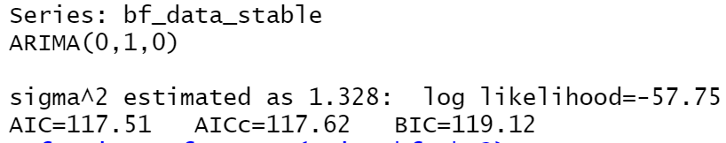
ARIMA Models:
Autoregressive Integrated Moving Average, ARIMA is the widely used time series model for analysis and forecasting. It combines two models to perform multivariate analysis.

Slide 34
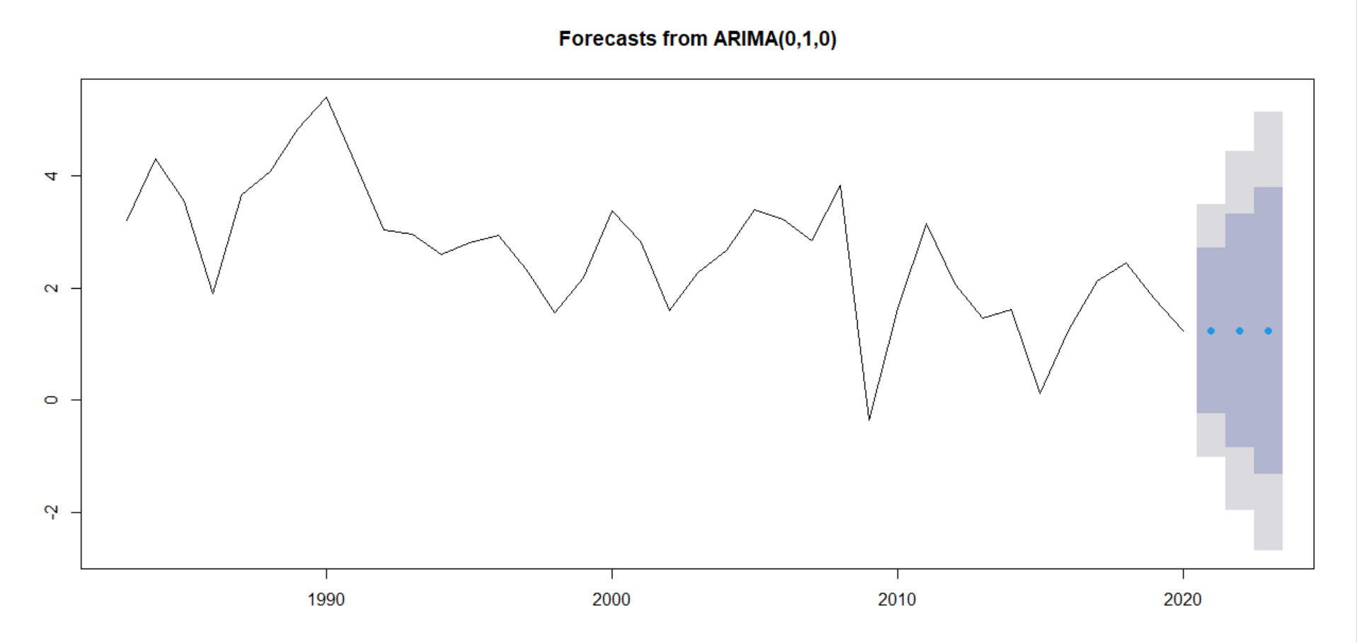

Slide 35
Validating the Forecast Models based on RMSE:
Model | Accuracy
Naïve Model | 1.15
Moving Average of 3 | 0.466
Moving Average 6 | 0.12
Moving Average 12 | 0.07
ETS Model | 0.92
Holt Winters Model | 1.26
Random Walk Forward | 1.15
ARIMA (Box – Jenkins) | 1.13

Slide 36
Conclusion:
Concluding, we can say that the best method for forecasting inflation rate is Moving average with order of 12 due to the
RMSE value of moving average 12 being closest to 0.
But the dataset we have used here doesn’t have any variables and there are many ways to further improve the forecasting,
The best way would be to use regression with the variables that influence the inflation rate.

